Slide 1
1.Processing of reverberant speech for time delay estimation.
Nov 2005, 9 citations on google scholar
Probleme:
-> Getting the time Delay of a reverberant speech with severals microphone.
->Getting it over a short amount of time
Suppose to perform better than the usually used generalized cross correlation approach.

Slide 2
Solutions :
Use of :
-the Hilbert transform of the LP Enveloppe
-the specificity of the speech and the huge variation of the glottal impulse.
-correlation
Goal: get a better signal, and rebuild one signal from severals microphone

Slide 3
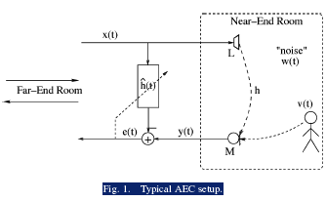
2. Acoustic Echo Cancellation and Doubletalk Detection Using Estimated Loudspeaker Impulse Responses
2005, 4 citations
Problem: solving the accoustic echo cancellation problems typical of call conferences for examples.

Slide 4
Solutions
Use of the time-independant impulse response of the loundspeaker.
Modification of the DTD and AEC algorithms already existing by including the impulse response of the Loundspeaker.

Slide 5
3. Speech pause detection for Noise Spectrum Estimation by tracking Power Envelope Dynamics
2002, 88 citations
Goal:
Detecting the pause in speech (ie when the speaker is not talking), in order to :
- get information about the surrounding noise
- not transmit any information

Slide 6
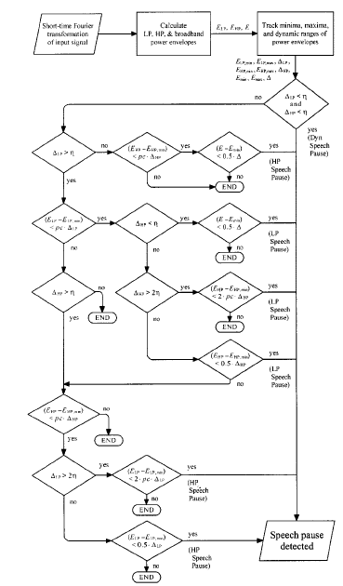
Solutions.
Algorithm using:
-Signal temporal power envelope (sum of the squares of the spectral components of input signal in each short time frame p).
Can perform better than the standardized G729 algorithm.

Slide 7
4. Modified Patchwork Algorithm: A Novel Audio Watermarking Scheme
64 Citations July 2003
Goal: including a mark into a speech signal in order to identify the speech.
That mark must be:
- Almost Inaudible
-Robust to time scaling, Low PassFiltering, encrypting, Down sampling.

Slide 8
Solutions
Inspirated from Image Watermarking.
-Encoding of the watermark using differents frequency transforms (DFT,Fourrier transform …)
-Use of a lot of probability in order to get a results (ie: if the signal have been watermarked or not, and the data contained in the watermarked signal).

